Slide 1
Tell your partner the story of The Three Little Pigs from the beginning to the end.

Slide 2
Did you know…???
You just told
the plot of the story !

Slide 3
Goal…
We will identify the plot of a story.
1 2 3 4

Slide 4
plot
A plot is the action or series of events in fiction or stories.

Slide 5
One easy way to think about plot is to think about the beginning, middle, and end of the story.

Slide 6
Plot Diagram…
climax
(middle)
rising action
falling action
beginning
end

Slide 7
To keep you interested, authors begin with interesting characters and situations.
In most stories, the plot concerns one or more problems or conflicts.

Slide 8
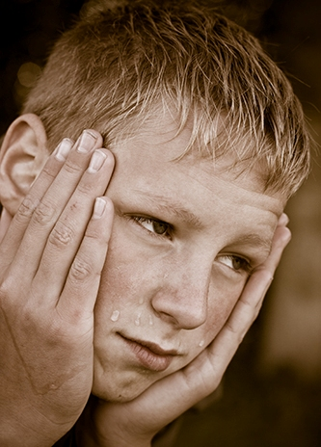
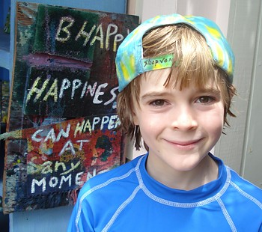
Sometimes…
important events in a plot are the changes
in a character’s feelings or attitudes.

Slide 9
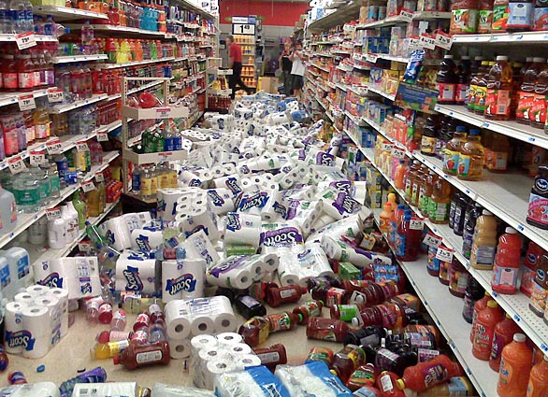
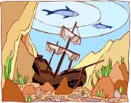
Sometimes…
…important events are action-packed events, such as earthquakes, space journeys, or shipwrecks.

Slide 10
Listen…
Listen for the plot in today’s story.
Use your graphic organizer to jot down a few notes at the beginning, middle, and end of the story.
Be ready to share.

Slide 11
Goal…
We will identify the plot of a story.
1 2 3 4

